Slide 1



CPT-based Multifunctional Grid-Tied Inverter with Type II Controller
Team G2 Power
Tiago Davi Curi Busarello, José de Arimatéia O. Filho, Alex Ferreira Silva, Paulo Fernando Silva, Helmo Kelis Morales Paredes
Notes:
Deixei título em negrito

Slide 2
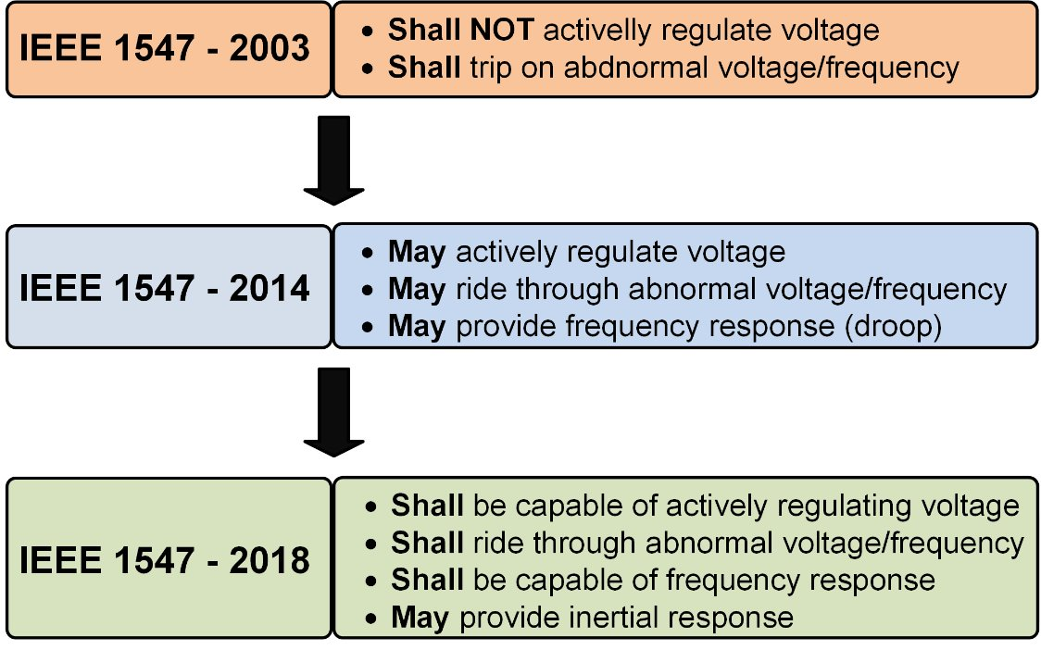
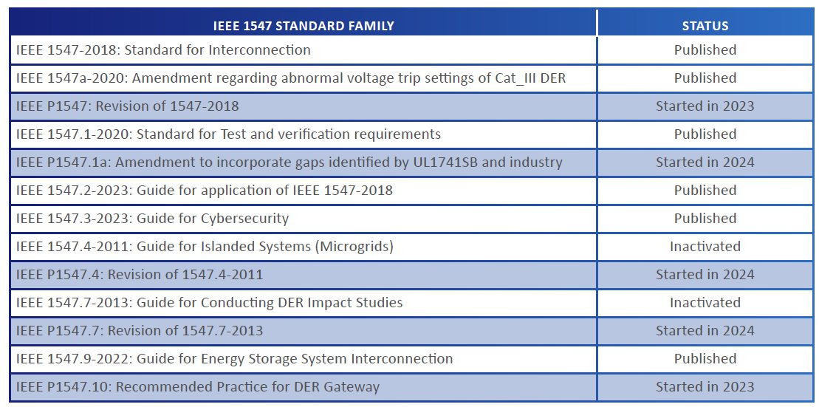




Introduction and motivation
Distributed Energy Resources (DERs) are becoming increasingly common in modern electric power systems.
1547 - IEEE Standard for Interconnection and Interoperability of Distributed Energy Resources with associated Electric Power Systems Interfaces
Prof. Tiago Davi Curi Busarello

Slide 3

Introduction and motivation
Prof. Tiago Davi Curi Busarello

Slide 4
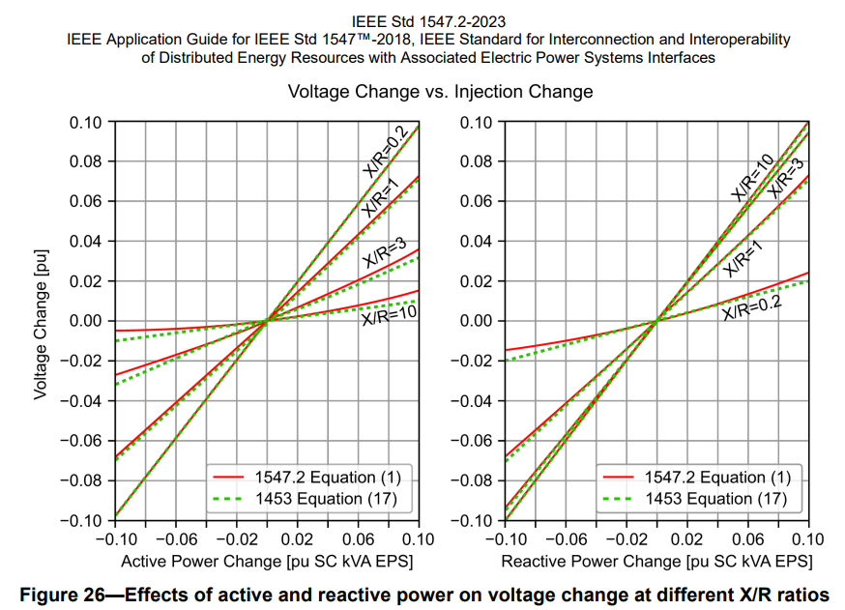
Introduction and motivation
Multifunctional inverter (ancillary services) appears as an attractive solution to the new updates of connecting DERs to the electric power system
Fig. 1: Effects of active and reactive power on voltage change at diferente X/R ratios.
Prof. Tiago Davi Curi Busarello
Notes:
Modifiquei legenda

Slide 5
Proposed System and Control
The point is: multifunciotnal converters (MFGTI) will are a reality in power systems. And it will be much more
Develop a multifunctional inverter to address the IEEE1547-2023
Even though the IEEE1547 does not talk about current Harmonic compensation, the proposed inverter is already ready for such a compensation.
Use of the Conservative Power Theory to compute power quantities of loads.
7 modes of operation.
Use just one current controller for all modes of operation, differently from switchable controller strategies in inverters with ancillary services.
Prof. Tiago Davi Curi Busarello
Notes:
Inseri MFGTI

Slide 6
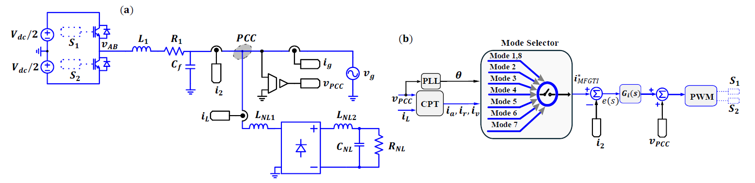
Proposed System and Control
Fig. 2: (a) Overview of MFGTI, (b) block control strategy.
Prof. Tiago Davi Curi Busarello

Slide 7
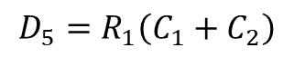

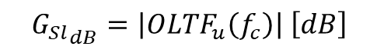
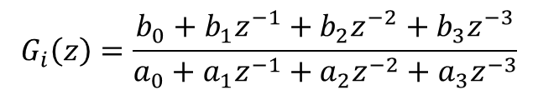
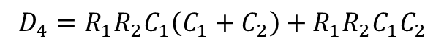
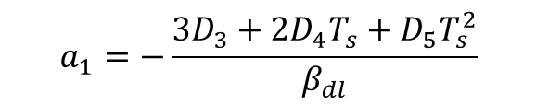
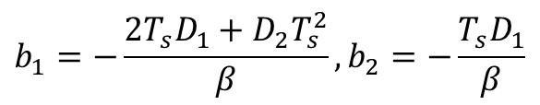

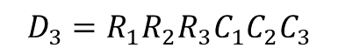
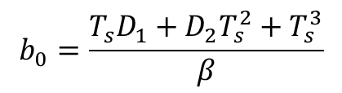

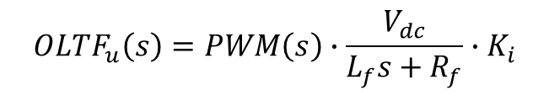

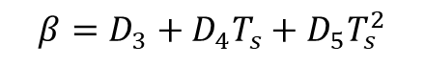

Proposed System and Control
Design current controller
Transfer function: Type-II current controller ($G_{i}\left(z\right)$)
$$OLTF_{u}\left(s\right)=PWM\left(s\right)∙\frac{V_{dc}}{L_{f}s+R_{f}}∙K_{i}$$
$$G_{i}\left(z\right)=\frac{b_{0}+b_{1}z^{−1}+b_{2}z^{−2}+b_{3}z^{−3}}{a_{0}+a_{1}z^{−1}+a_{2}z^{−2}+a_{3}z^{−3}}$$
$$φ_{sl}=∡OLTF_{u}\left(f_{c}\right) \left[°\right]$$
Coefficients
where:
$${G_{Sl}}_{dB}=\left|OLTF_{u}\left(f_{c}\right)\right| \left[dB\right]$$
$$b_{0}=\frac{T_{s}D_{1}+D_{2}T_{s}^{2}+T_{s}^{3}}{β}$$
$$D_{1}=R_{2}C_{1}C_{3}\left(R_{1}+R_{3}\right)$$
$$D_{2}=R_{2}C_{1}+R_{1}C_{3}+R_{3}C_{3}$$
Type-II current controller ($G_{i}\left(z\right)$)
$$b_{1}=−\frac{{2T}_{s}D_{1}+D_{2}T_{s}^{2}}{β}, b_{2}=−\frac{T_{s}D_{1}}{β}$$
$$D_{3}=R_{1}R_{2}R_{3}C_{1}C_{2}C_{3}$$
pole at the origin and single zero–pole pairs
enhances robustness against load variations
external disturbances
efficient and relatively simple solution
alternative controller in MFGTI
$$a_{1}=−\frac{3D_{3}+2D_{4}T_{s}+D_{5}T_{s}^{2}}{β_{dl}}$$
$$D_{4}=R_{1}R_{2}C_{1}{\left(C_{1}+C_{2}\right)+R_{1}R_{2}C_{1}C}_{2}$$
$$D_{5}=R_{1}\left(C_{1}+C_{2}\right)$$
$$a_{2}=\frac{3D_{3}+D_{4}T_{s}}{β}, a_{3}=−\frac{D_{3}}{β}$$
$$β=D_{3}+D_{4}T_{s}+D_{5}T_{s}^{2}$$
Prof. Tiago Davi Curi Busarello
Notes:
Structurally, this compensator combines a pole at the origin, which provides the integral action required to eliminate steady-state error, with a pole-zero pair that introduces phase lead [11]. The integral action ensures accurate tracking even under persistent disturbances, while the phase lead component counteracts the inherent delays of the plant, improving phase margin and enabling faster and more stable dynamic response [12].

Slide 8
Modes of Operation
Mode 1: Injecting Active Power
Mode 2: Full Shunt Power Filter
Mode 3: Reactive Power Compensation (Statcom)
Mode 4: Harmonic compenstation
Mode 5 Active and Reactive power Injection
Mode 6: Active power consumption and reative power injection
Mode 7: stand-by
More modes could be added (combination of them)
Prof. Tiago Davi Curi Busarello

Slide 9
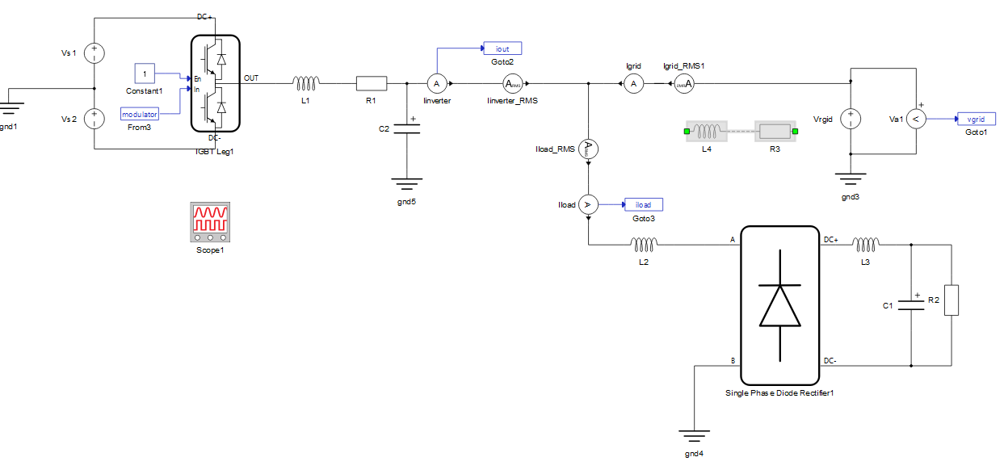
Model – Power Structure (TyphoonSim® 2025.2)
NLL
MFGTI
Power grid
Fig. 3: Power Structure of MFGTI in TyphoonSim® 2025.2.
Prof. Tiago Davi Curi Busarello
Notes:
Fig. 3: Power Structure of MFGTI in TyphoonSim® 2025.2

Slide 10
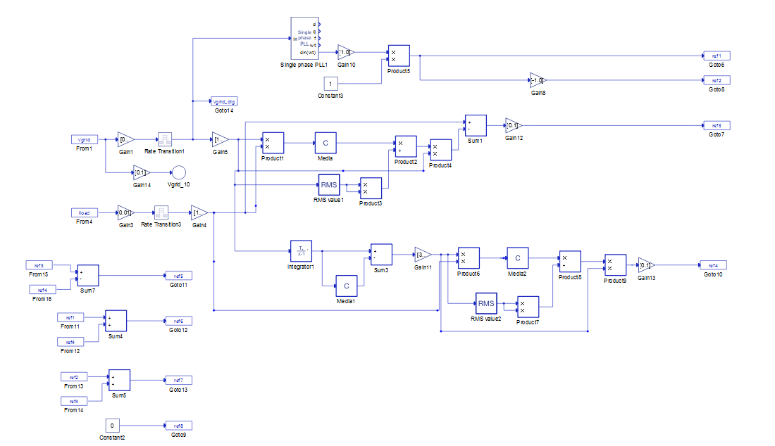
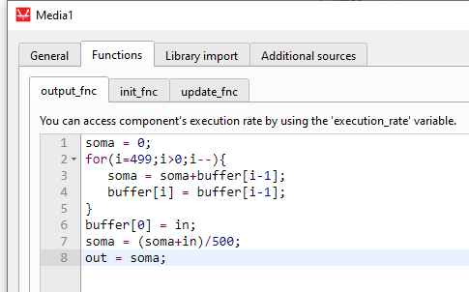
Model – Reference Generators (TyphoonSim® 2025.2)
Fig. 4: Reference Generators of MFGTI in TyphoonSim® 2025.2.
Prof. Tiago Davi Curi Busarello
Notes:
Fig. 4: Refrence Generators of MFGTI in TyphoonSim® 2025.2

Slide 11
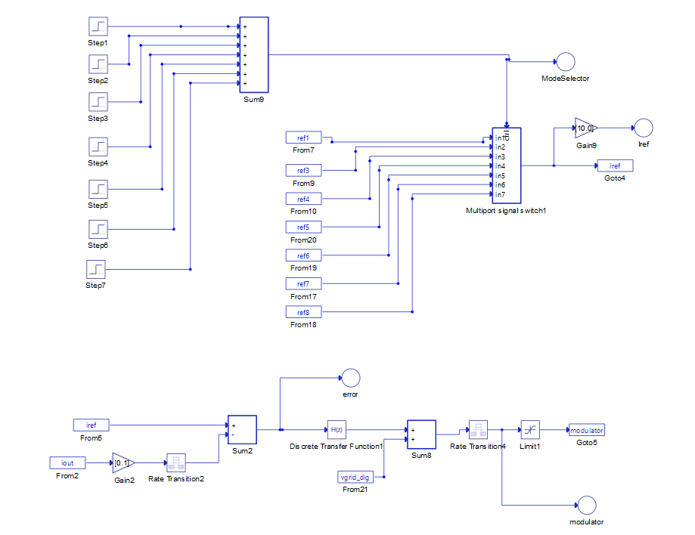
Model – Model Selector and Current Controller (TyphoonSim® 2025.2)
(a)
Mode Selector
(b)
Current Controller:
Fig. 5: (a) Model selector; (b) current controller of MFGTI.
Prof. Tiago Davi Curi Busarello
Notes:
Fig. 5: (a) Model selector; (b) current controller of MFGTI

Slide 12
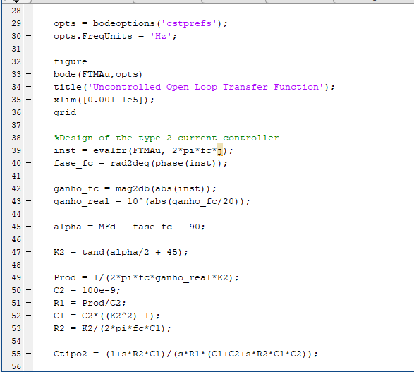
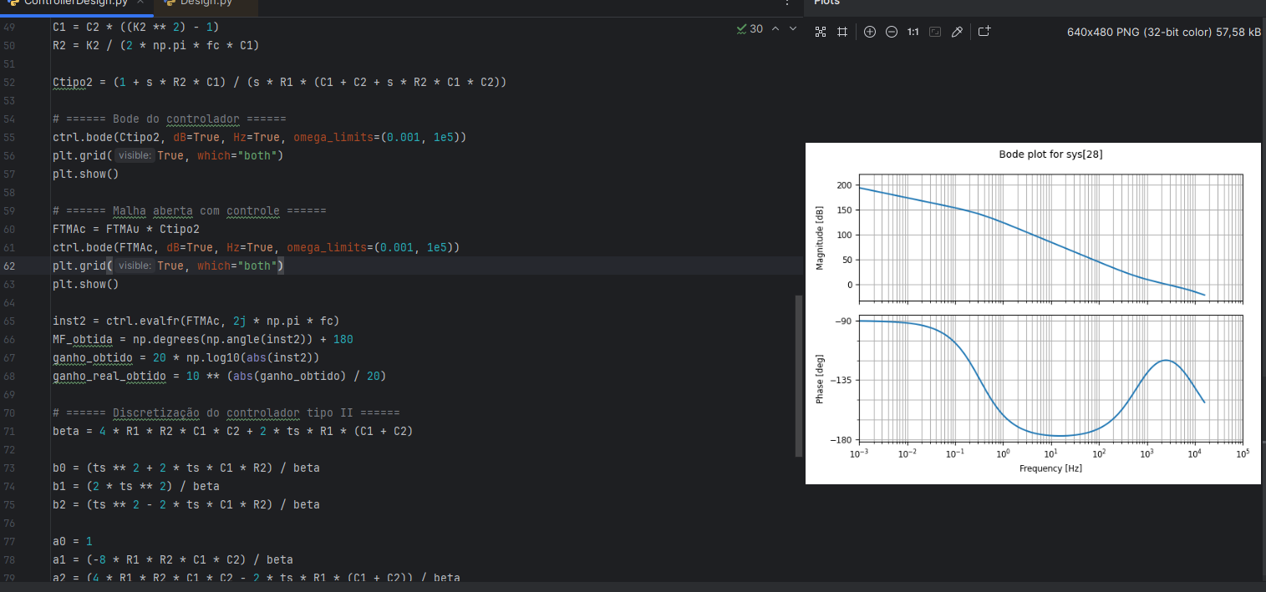
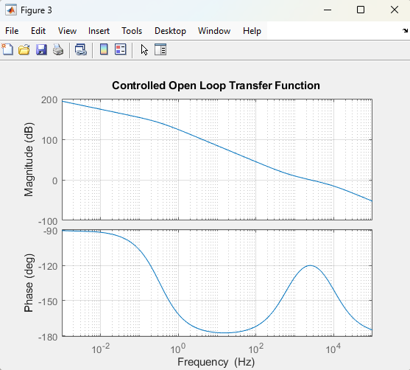
Model – Scripts in Matlab® and Python
(i) Script in Matlab
(ii) Script in Python
Prof. Tiago Davi Curi Busarello

Slide 13
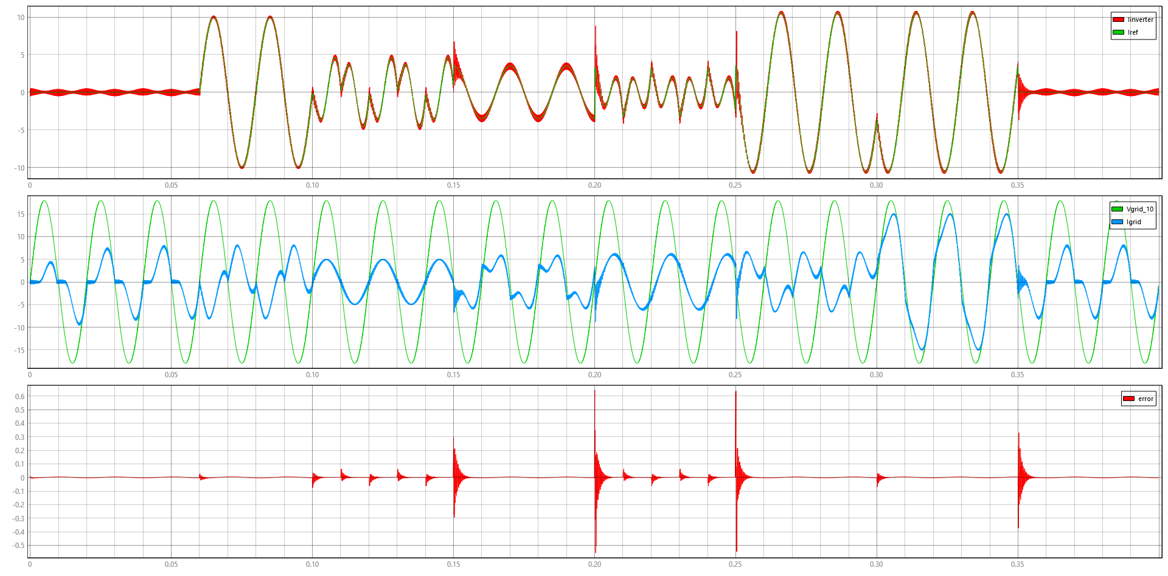
Model – Mode Selector and Current Controller (TyphoonSim 2025.2)
Trade-off between filter size and power quality
Fig. 6: (a) current reference and MFGTI current; (b) grid current, grid voltage/10; (c) error.
Prof. Tiago Davi Curi Busarello

Slide 14
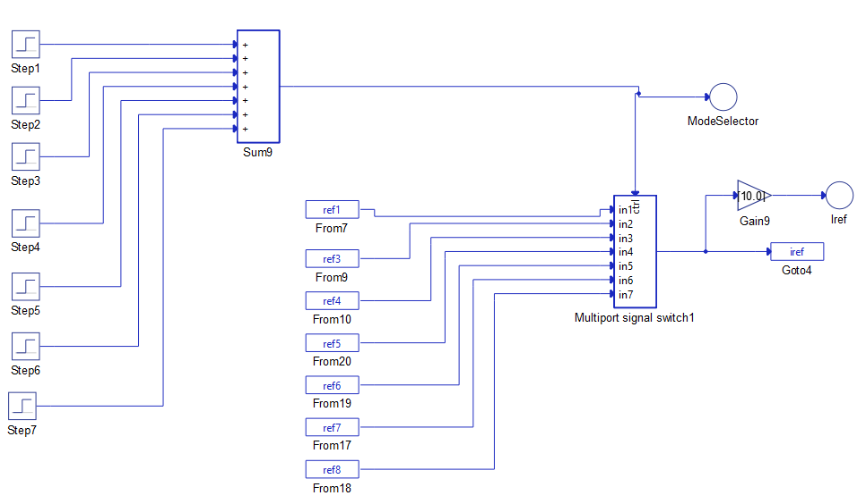
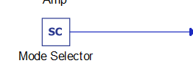
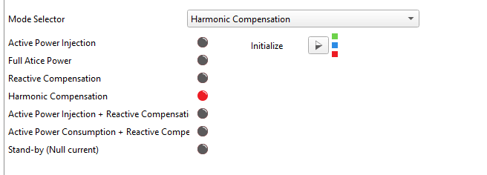
Extension of our model
Fig. 7: Extension of the proposed model.
Prof. Tiago Davi Curi Busarello

Slide 15
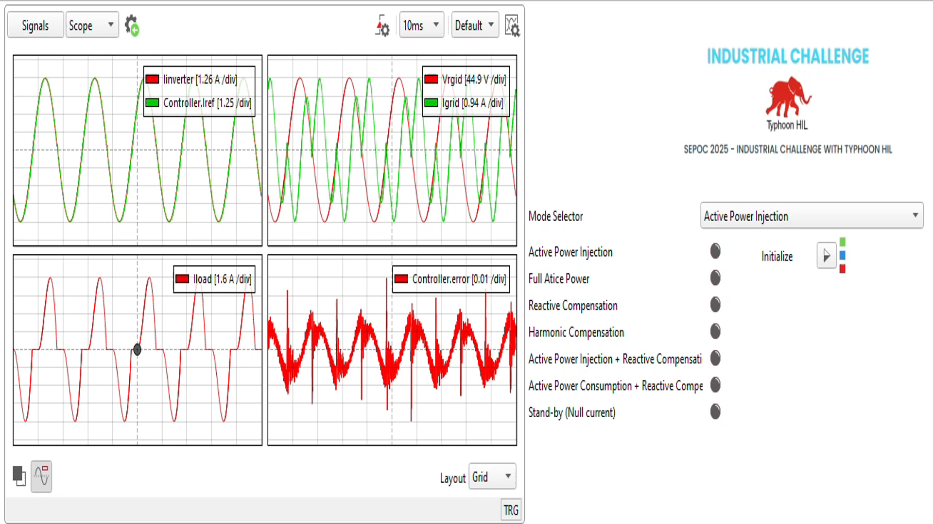
Extension of our model
Fig. 8: Results from the extension of the proposed model.
Prof. Tiago Davi Curi Busarello

Slide 16
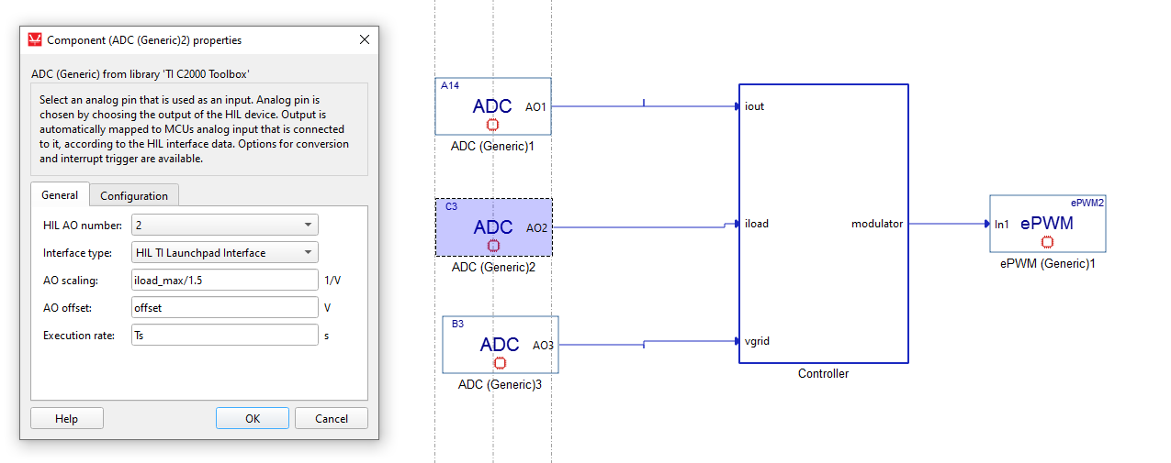

Extension of our model
Fig. 8: Overview of the experimental MFGTI set-up.
Complete demonstration: https://youtu.be/aGTE193b3e0
Prof. Tiago Davi Curi Busarello

Slide 17


Freely available files
https://busarello.prof.ufsc.br/challenge.html
https://github.com/TeamG2Power
Prof. Tiago Davi Curi Busarello

Slide 18
Conclusions
The proposed multifunctional inverter is an attractive solution for DER to address the new requirements of IEEE1547.
Using only one controller for all modes of operation proved to be a good choice instead of using switchable controller when performing ancillary services.
The CPT could compute accurately the power quantities for the operation modes.
The proposed inverter is ready to inject the required active and reactive power for contributing to regulate voltage and frequency of the point of common coupling.
Prof. Tiago Davi Curi Busarello

Slide 19
Thank you!!
Questions?
tiago.busarello@ufsc.br

